Slide 1

China Real Estate Credit :
Situation Overview and Restructuring Challenges
Note: Approved cover photo images are available for download at dam.kirkland.com.
Presentation to:
September 7, 2022 – 22nd Annual International Insolvency Conference: Impacts of Global Events on the International Insolvency Practice

Slide 2
Agenda
What Happened
What Caused the Crisis
Chinese Government Response
Restructuring Challenges
Outlook

Slide 3
What happened
Markit iBoxx China Real Estate USD High Yield Total Return Index

Slide 4
What happened (cont’d)
Distribution of China Real Estate High-yield Bonds Prices
Source: Bloomberg Asia USD High Yield Index

Slide 5
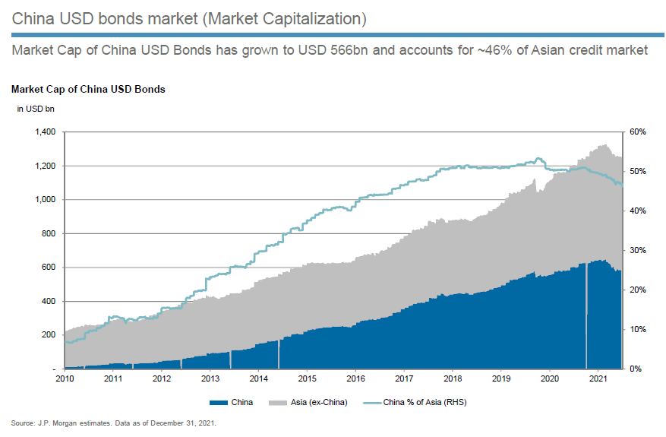
What happened (cont’d)

Slide 6
What happened (cont’d)
As of the end of August 2022, China Real Estate is still the largest segment within Asia high-yield bonds.
Note: Based on total notional outstanding. The figures above are derived from ICE-BAML Asian Dollar HY Index and do not include high-yield bonds that are not in the ICE-BAML Asian Dollar HY Index.

Slide 7
What happened (cont’d)
Asia high-yield corporates - composition by sector as of December 2021
Source: Bloomberg, Barclays Research

Slide 8
What Caused the Crisis
Long period of success/massive amount of debts racked up by developers, including offshore bonds
Bond tenures increasingly short / maturity wall
Many developers had high leverage
Onshore bank lending constrained

Slide 9
What Caused the Crisis (cont’d)
Three red lines imposed by Chinese government in 2020
  Total liabilities / Total asset
  Net debt / Book value
  Cash / Short term debt
  Difficult for many developers to scale back expansion and comply with three ratios

Slide 10
What Caused the Crisis (cont’d)
COVID policies imposed by government
  Negative impact on the sales
Pre-sales
  Most properties are pre-sold; the proceeds are/should be used to finish the project
High-yield bonds – require refinancing as cash flows insufficient

Slide 11
What Caused the Crisis (cont’d)
Death spiral
  Lack of refinancing impacts project completion
  Further impact on sales
  Offshore capital markets closed

Slide 12
Government response
Top priority - social stability
  Ensuring projects are finished and delivered
  Ensuring pre-sale proceeds are only used to finish projects
Government’s response has been limited
  Designated funds at local and central level to ensure projects are finished and delivered
  Lower mortgage rates to stimulate purchases

Slide 13
Restructuring challenges
Most offshore bonds are structurally subordinated to secured and unsecured onshore debt
Often the amount of onshore debt dwarfs the amount of offshore debt
  In Evergrande, the total borrowings are approximately US$80 billion and the offshore bonds are approximately US$20 billion
Weakness of corporate governance and internal accounting systems exposed

Slide 14
Restructuring challenges (cont’d)
Challenges of enforcement in China
  time/costs/lack of precedent
  uncertain legal status of some claims (i.e. keepwell agreements)
  Role of local governments in protecting local companies

Slide 15
Outlook
Operating environment remains very challenging and conditions need to affirmatively improve for many companies to survive
Government policies are inadequate and primarily designed to ensure projects are completed (repayment of foreign creditors is not high on the list of priorities)
Long extensions provide some hope of better recoveries, which may be preferable to significant write-offs now

